Slide 1


Slide 2

Day 2: Agenda
Introduction to Model Evaluation Metrics
Regression Model Evaluation Metrics
Mean Absolute Error (MAE)
Mean Squared Error (MSE)
Root Mean Squared Error (RMSE)
R-squared (Coefficient of Determination)
Introduction to Multiple Linear Regression
Inbuilt Dataset: California Housing
Model Evaluation with the California Housing Dataset
Practical Example
Interpretation and Insights

Slide 3
Model Evaluation Metrics for Regression
Mean Squared Error (MSE):
Measures the average squared difference between predicted and actual values.
Larger MSE values indicate greater prediction errors.
Root Mean Squared Error (RMSE):
The square root of MSE.
Provides a more interpretable metric in the same units as the target variable.
Mean Absolute Error (MAE):
Measures the average absolute difference between predicted and actual values.
Less sensitive to outliers compared to MSE.
R-squared (R2) Score:
Represents the proportion of variance in the target variable explained by the model.
R2 score ranges from 0 to 1, with higher values indicating better model fit.
Notes:
Note: Use – Jupyter File for this example - Multiple LR - Housing Dataset.ipynb

Slide 4
Mean Absolute Error (MAE)
Mean Absolute Error (MAE)
MAE quantifies average prediction error in regression.
Formula: MAE = (1/n) Σ |actual - predicted|.
Lower MAE indicates closer predictions to actual values.
Units match the target variable.
Use Cases
Suitable for equal importance of overestimation and underestimation.
Examples: sales, temperatures, stock prices.
Advantages
Robust to outliers.
Easy to understand.
Limitations
Doesn't penalize large errors more.
Doesn't reveal error direction.
MAE helps gauge average prediction accuracy, especially when errors in both directions have equal significance.

Slide 5
Mean Squared Error (MSE)
Mean Squared Error (MSE)
MSE assesses regression model accuracy.
Formula: MSE = (1/n) Σ (actual - predicted)^2.
Emphasizes larger errors more.
Interpretation
Lower MSE indicates closer predictions.
Gives weight to larger errors.
Use Cases
Common in finance, engineering, and regression.
Suitable for tasks with varying error magnitudes.
Advantages
Sensitivity to larger errors.
Widely used in regression analysis.
Limitations
Less intuitive due to squared terms.
Less robust to outliers than MAE.

Slide 6
R-squared (R²)
R-squared (R²)
Measures variance explained by the model.
Ranges from 0 (poor fit) to 1 (perfect fit).
Higher R² = better fit.
Use Cases
Evaluates model's explanatory power.
Indicates goodness-of-fit.
Advantages
Clear measure of model effectiveness.
Limitations
Limited applicability beyond training data.

Slide 7
Model Evaluation
A practical example of model evaluation is presented, where you've built a house price prediction model, and you calculate MAE, MSE, and R2 to evaluate its performance.
Dataset: California Housing Prices
Notes:
Note: Use – Jupyter File for this example - Model Evaluation - California Housing Prices .ipynb

Slide 8
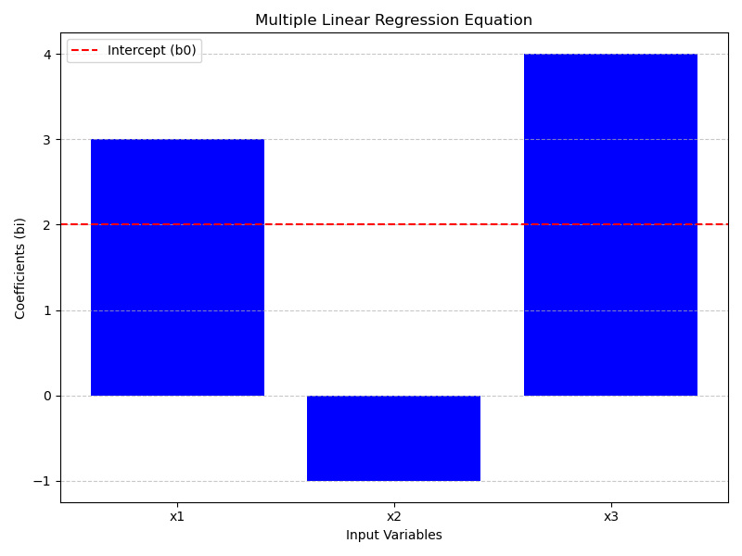
Multiple Linear Regression
Multiple Linear Regression is an extension of simple linear regression.
It uses multiple input variables (features) to predict a target variable.
The relationship is expressed by the equation:
y = b0 + b1x1 + b2x2 + ... + bnxn.
y: Target variable (what we want to predict).
xi: Feature or input variable (e.g., hours studied, age, previous exam scores).
bi: Coefficients (slopes) for each feature, indicating their impact on the target.
b0: Intercept (the expected target value when all features are zero).
Example Use Case​
Predicting a house's price based on multiple features like square footage, number of bedrooms, and location.​
The model learns the best-fit coefficients (bi) to make predictions.

Slide 9
Question
Suppose you are tasked with predicting house prices based on various features such as area, number of bedrooms, number of bathrooms, and more. You have a dataset containing this information. Explain the steps you would take to build a multiple linear regression model for this task, including data preprocessing, model training, evaluation, and interpretation of results. Additionally, how would you visualize the model's performance?
Notes:
Note: Use – Jupyter File for this example - Multiple LR - Housing Dataset.ipynb

Slide 10
In-Built Dataset
In Jupyter Notebook, there are several datasets that come pre-installed with popular libraries like Seaborn and Scikit-Learn, which can be loaded and used for practice or demonstration purposes. Here's how you can check which datasets are available and how to load them:
Using Seaborn Datasets:
Seaborn is a data visualization library in Python, and it provides a few built-in datasets that you can use. To see a list of available datasets and load them, you can do the following:
import seaborn as sns
sns.get_dataset_names()
Load a dataset:
For example, you can load the "tips" dataset as follows:
tips_data = sns.load_dataset("tips")
Notes:
Note: Use – Jupyter File for this example

Slide 11
In-Built Dataset
Using Scikit-Learn Datasets:
Scikit-Learn also provides some built-in datasets primarily for machine learning practice. Here's how you can access and load Scikit-Learn datasets
Import Scikit-Learn:
from sklearn.datasets import load_iris, load_digits
Load a dataset:
For example, you can load the Iris dataset as follows:
iris_data = load_iris()
Notes:
Note: Use – Jupyter File for this example

Slide 12
Question
Task: In this exercise, you will work with the California Housing dataset, which contains data related to housing prices in California. Your goal is to load the dataset, perform some data exploration, and then train and evaluate a Linear Regression model to predict housing prices.
Instructions:
Load the California Housing dataset from Scikit-Learn.
Explore the dataset by checking its dimensions, viewing the first few rows, and obtaining summary statistics.
Split the dataset into features (X) and the target variable (y).
Split the data into training and testing sets, with a test size of 20%.
Train a Linear Regression model on the training data.
Evaluate the model using the testing data by calculating Mean Squared Error (MSE) and R-squared (R2) scores.
Interpret the results and provide insights into the model's performance.
Notes:
Note: Use – Jupyter File for this example - Model Evaluation - California Housing Prices .ipynb

Slide 13
Questions ?

Slide 14
Thank You !

